Slide 1

CORNERSTONE PROJECT BASED LEARNING
PROJECT - EMPLOYEE PAYROLL MANAGEMENT SYSTEM
DATABASE MANAGEMENT SYSTEM

Slide 2
TEAM MEMBERS
M . VISHNU VARDHAN REDDY
A . PRATHYUSHA
CH . SATYA SARISHMA
T. NIKHIL
— 25B11CS618
— 25B11CS726
— 25B11CS181
— 25B11CS959

Slide 3
PROBLEM STATEMENT
Manual payroll management is time-consuming.
Employee records may be difficult to maintain.
Manual salary calculations can cause errors.
Attendance and leave records may be scattered.
Maintaining payroll history becomes difficult.
Generating reports manually requires extra effort.

Slide 4
NEED FOR THE SYSTEM
To reduce manual work
To improve payroll accuracy
To maintain centralized employee records
To simplify attendance management
To manage leave efficiently
To maintain salary and payroll information
To reduce data redundancy
To improve transparency and reporting

Slide 5
OBJECTIVES
Maintain employee information
Manage department information
Track attendance and leave
Maintain salary details
Manage bonuses and deductions
Generate payroll records
Reduce manual calculations
Maintain accurate records
Generate reports

Slide 6
REQUIREMENT ANALYSIS
The System Should Be Able To :
Add employee records
Update employee information
Delete records when required
Retrieve employee information
Manage departments
Record attendance
Manage leave records
Maintain payroll information
Calculate / manage salary components

Slide 7
NON FUNCTIONAL REQUIREMENTSAND END USERS
Non Functional Requirements :
Accuracy – Payroll information should be correct and accurate.
Security – Employee and salary information should be protected from unauthorized access.
Reliability – The system should work consistently without failures.
Performance – Information should be retrieved efficiently.
Usability – The system should be easy to use and understand.
Data Integrity – Records should remain accurate and consistent.
Maintainability – The database should be easy to maintain and update.
End Users :
HR/ Administrator Payroll/ Accounts Staff Management

Slide 8
ER DESIGN OVERVIEW
An entity is a real world object about which we want to store information in a database
MAIN ENTITIES
Our ER diagram contains:
Departments
Employees
Attendance
Leaves
Payrolls
Jobs

Slide 9
ENTITIES, ATTRIBUTES & PRIMARY KEYS
Entity | Attributes | Primary key
Departments | DepartmentID,Department Name,Location | DepartmentID
Employees | EmployeeID,employee,phone Name,Email | EmployeeID
Attendence | AttendenceID, Attendence Date,CheckIn,Checkout,status | AttendenceID
Leaves | LeaveID,LeaveType,LeaveStatus, Reason,StartDate,EndDate | LeaveID
Payrolls | Payroll ID,SalaryMonth,BasicSalary, Bonus,Deduction,NetSalary | PayrollID
Jobs | Job Title ,Job Description, Basic Salary | JobID

Slide 10
Relationship
Cardinality
Departments HAS employees
1 : M
Employees RECORDS Attendence
1 : M
Employees APPLIES FOR Leaves
1 : M
Employees PROCESSED FOR Payrolls
1 : M
Employees HAS Jobs
M : 1
10

Slide 11
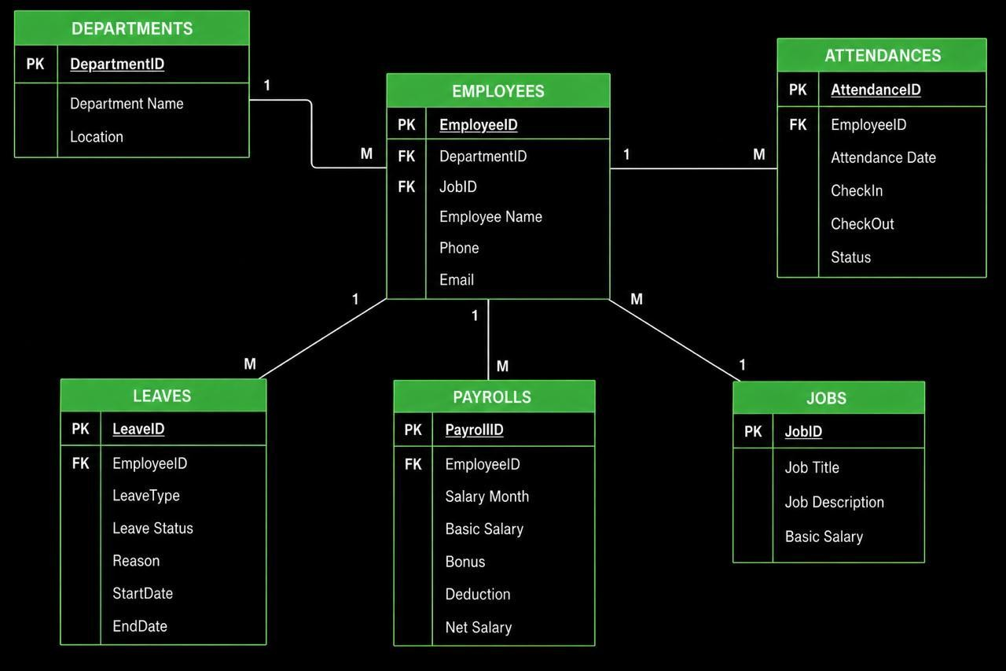
SCHEMA MODEL
M
M
M
M

Slide 12
JUSTIFICATION OF ENTITIES AND RELATIONSHIPS
Why are Entities included ?
Department → Used to organize employees according to their respective departments.
Employee → Used to store basic information about employees.
Attendance → Used to maintain the daily attendance records of employees.
Leave → Used to manage employee leave information.
Payroll → Used to maintain salary, bonus, deduction, and net salary information.
Why are Relations Included ?
Department – Employee → connects employees to their department.
Employee - Attendance → connects employees to attendance records.
Employee – Leave | → connects | employees | to leave records.
Employee – Payroll | → connects | employees | to payroll records.
12

Slide 13

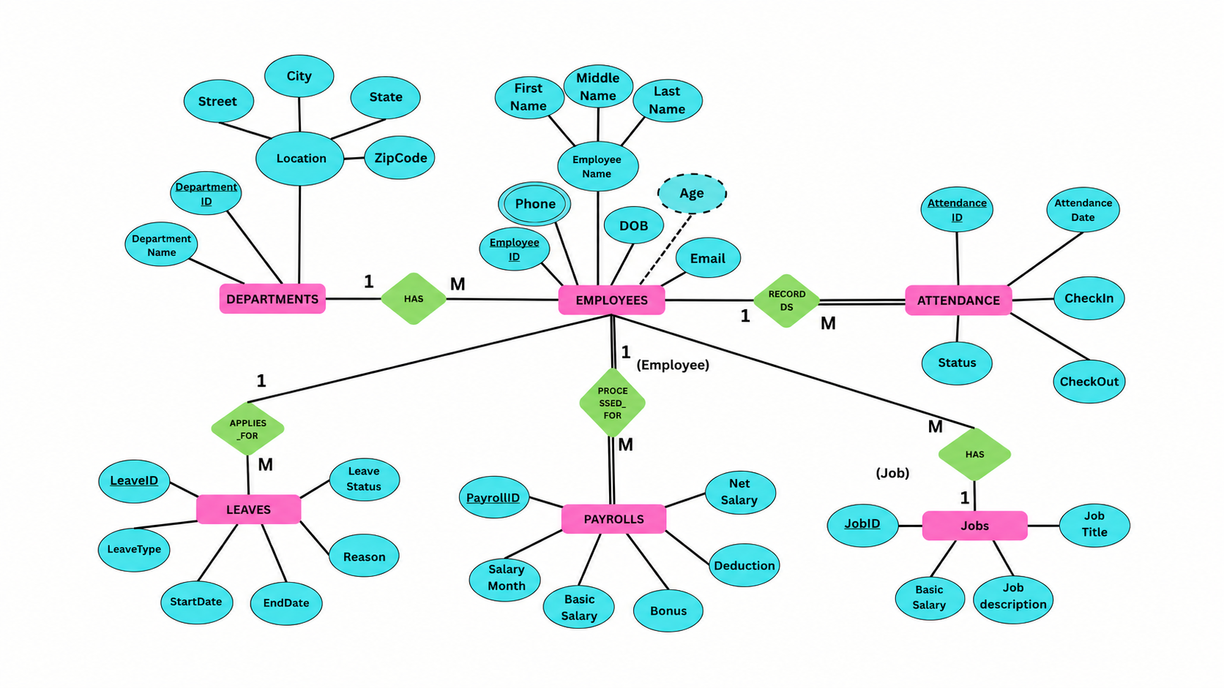
ER MODEL
09-08-2026
Course Name
Faculty Name, Designation, Dept.

Slide 14
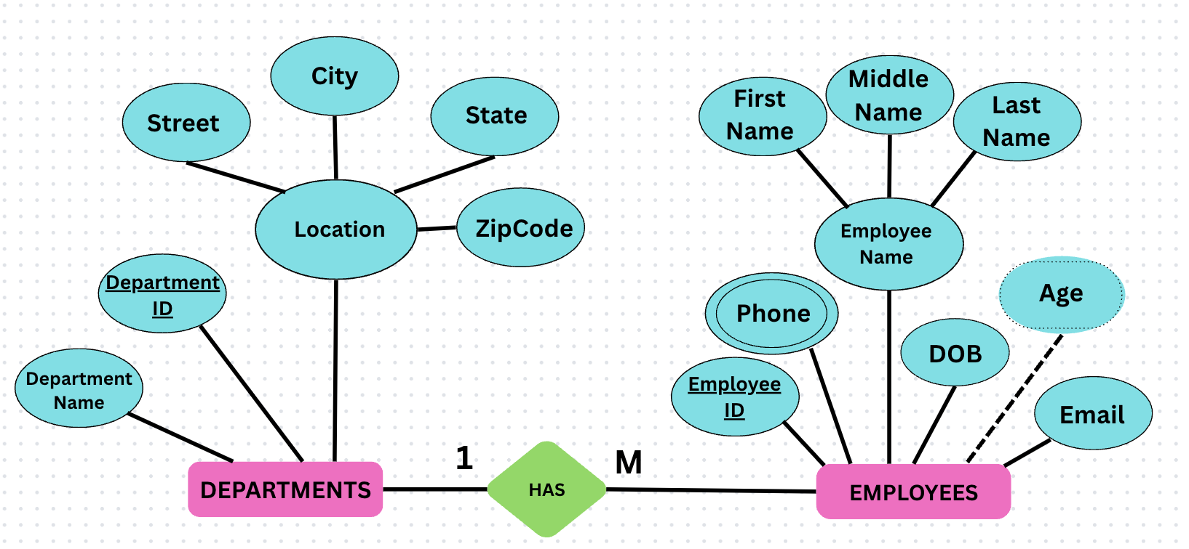
TABLES CREATION
DEPARTMENT TABLE
CREATE TABLE DEPARTMENT
(
DEPARTMENT_ID INTEGER PRIMARY KEY,
DEPARTMENT_NAME VARCHAR(30) NOT NULL,
STREET VARCHAR(50),
CITY VARCHAR(30),
STATE VARCHAR(30),
ZIPCODE VARCHAR(10)
);

Slide 15
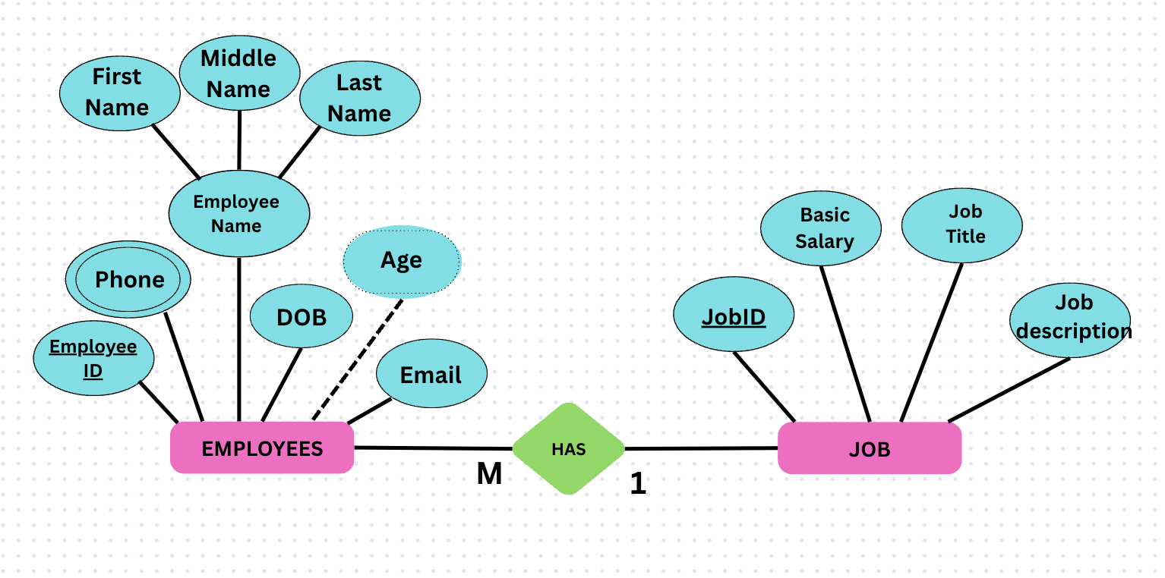
JOB TABLE
CREATE TABLE JOB
(
JOB_ID INTEGER PRIMARY KEY,
JOB_TITLE VARCHAR(40) NOT NULL,
JOB_DESCRIPTION VARCHAR(100),
BASIC_SALARY INTEGER
);

Slide 16
EMPLOYEE TABLE
CREATE TABLE EMPLOYEE
(
EMPLOYEE_ID NUMBER(5) PRIMARY KEY,
FIRST_NAME VARCHAR(20) NOT NULL,
MIDDLE_NAME VARCHAR(20) NOT NULL,
LAST_NAME VARCHAR(20) NOT NULL,
DOB DATE,
EMAIL VARCHAR(50),
DEPARTMENT_ID INTEGER,
JOB_ID INTEGER,
CONSTRAINT FK_EMP_DEPT FOREIGN KEY (DEPARTMENT_ID)REFERENCES DEPARTMENT(DEPARTMENT_ID),
CONSTRAINT FK_EMP_JOB FOREIGN KEY
(JOB_ID) REFERENCES JOB(JOB_ID)
);

Slide 17
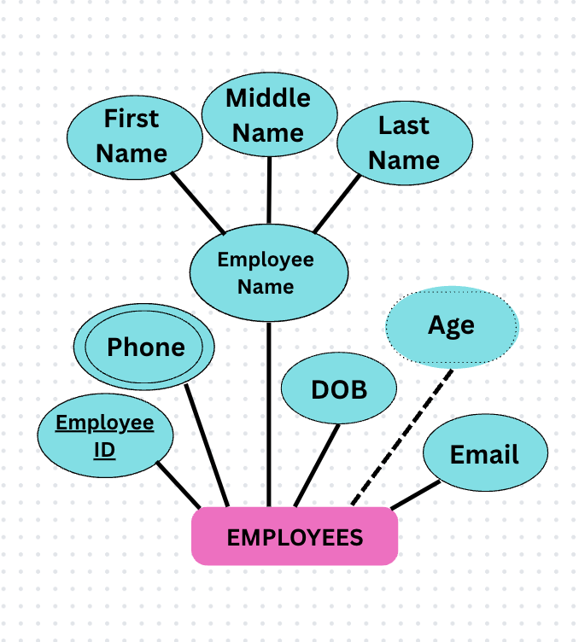
EMPLOYEE_PHONE TABLE
CREATE TABLE EMPLOYEE_PHONE
(
EMPLOYEE_ID INTEGER,
PHONE VARCHAR(15),
CONSTRAINT PK_EMP_PHONE PRIMARY KEY (EMPLOYEE_ID, PHONE),
CONSTRAINT FK_PHONE_EMP FOREIGN KEY (EMPLOYEE_ID) REFERENCES EMPLOYEE(EMPLOYEE_ID)
);

Slide 18
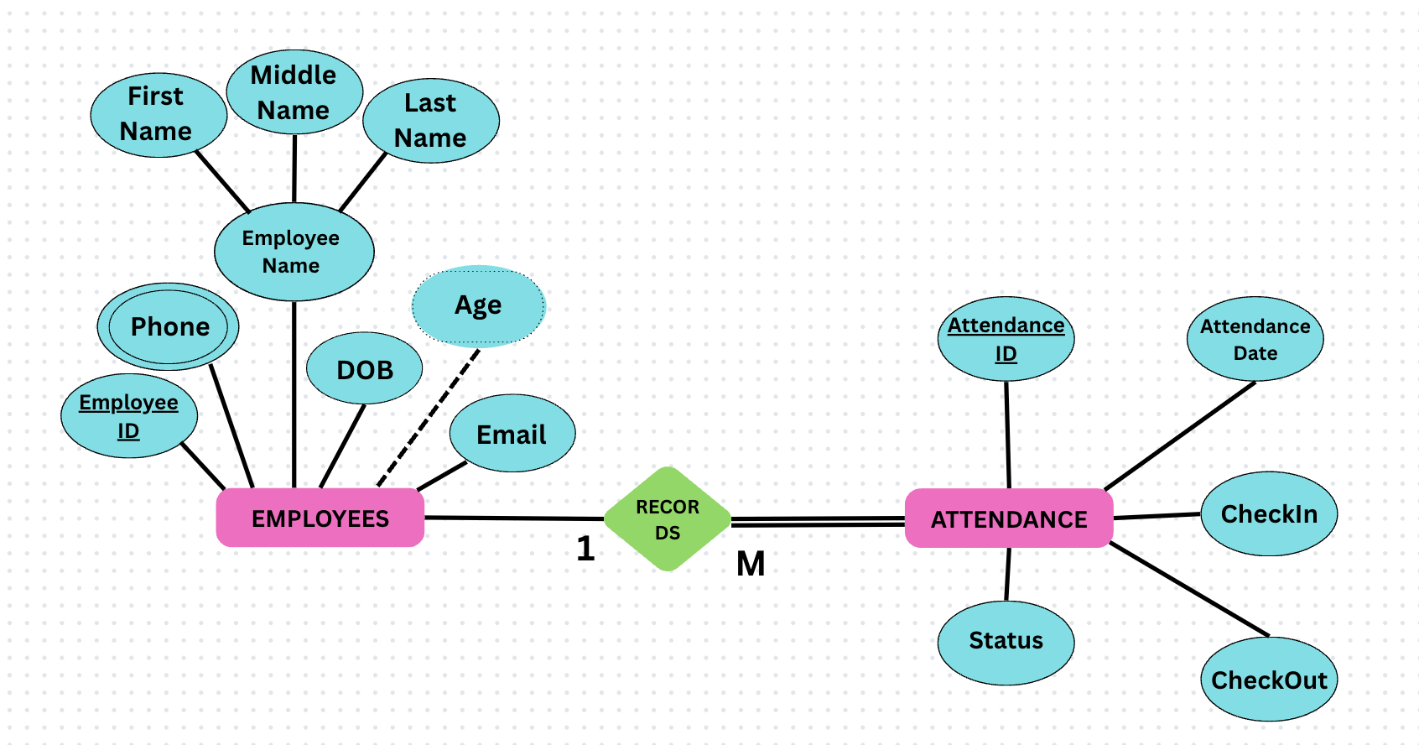
ATTENDENCE TABLE
CREATE TABLE ATTENDANCE
(
ATTENDANCE_ID INTEGER PRIMARY KEY,
EMPLOYEE_ID INTEGER NOT NULL,
ATTENDANCE_DATE DATE NOT NULL,
CHECKIN VARCHAR(10),
CHECKOUT VARCHAR(10),
STATUS VARCHAR(15),
CONSTRAINT FK_ATT_EMP FOREIGN KEY (EMPLOYEE_ID) REFERENCES EMPLOYEE(EMPLOYEE_ID)
);

Slide 19
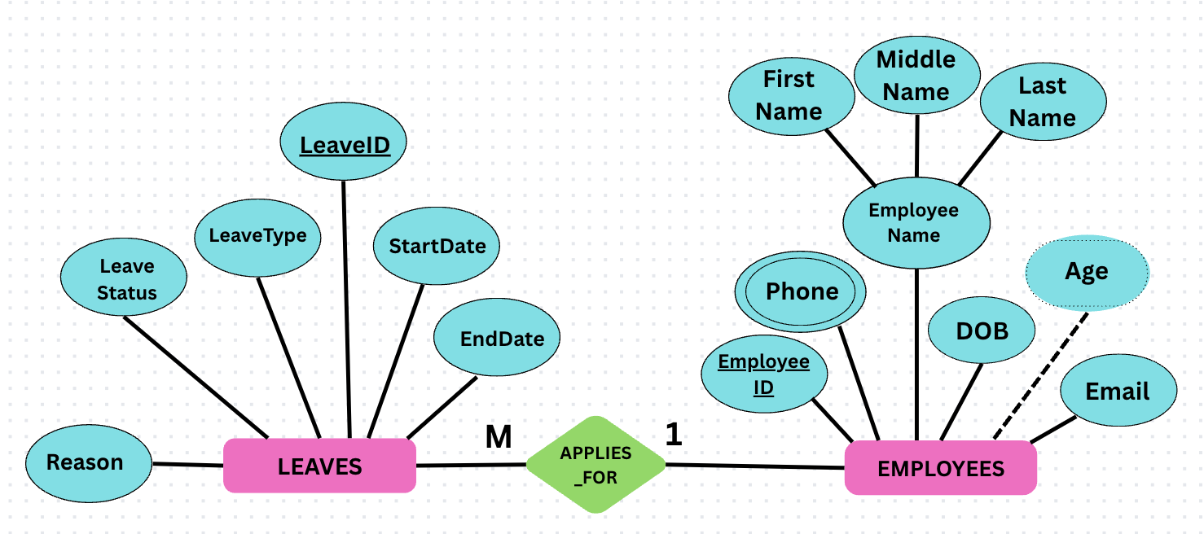
LEAVE TABLE
CREATE TABLE LEAVE
(
LEAVE_ID INTEGER PRIMARY KEY,
EMPLOYEE_ID INTEGER NOT NULL,
LEAVE_TYPE VARCHAR(20),
START_DATE DATE,
END_DATE DATE,
LEAVE_STATUS VARCHAR(20),
REASON VARCHAR(100),
CONSTRAINT FK_LEAVE_EMP FOREIGN KEY (EMPLOYEE_ID) REFERENCES EMPLOYEE(EMPLOYEE_ID)
);

Slide 20
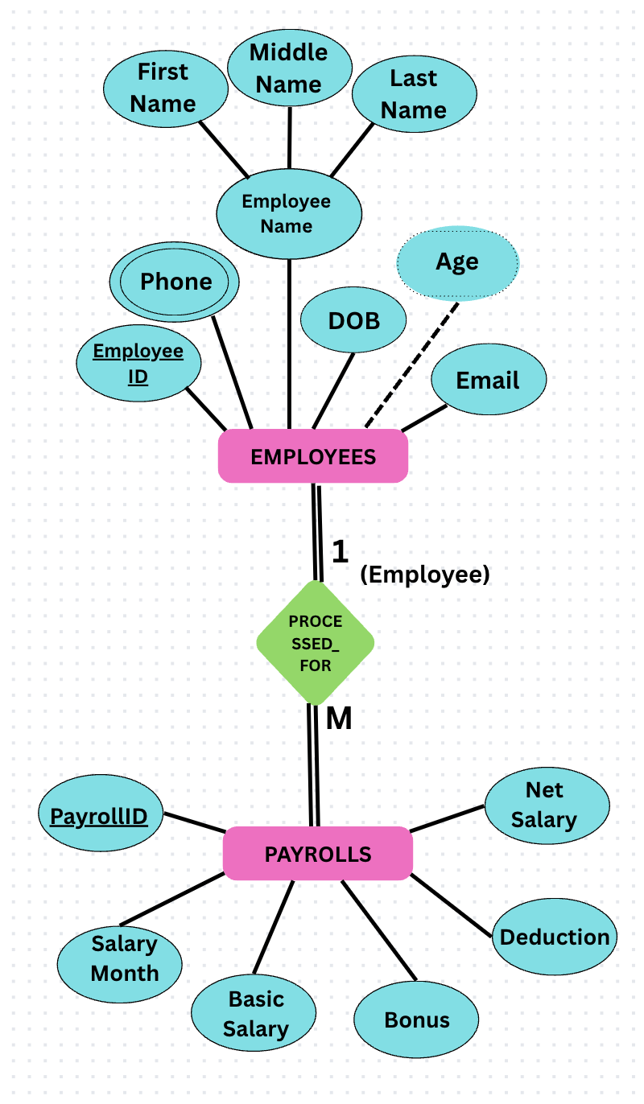
PAYROLL TABLE
CREATE TABLE PAYROLL
(
PAYROLL_ID INTEGER PRIMARY KEY,
EMPLOYEE_ID INTEGER NOT NULL,
SALARY_MONTH VARCHAR(20),
BASIC_SALARY INTEGER,
BONUS INTEGER,
DEDUCTION INTEGER,
NET_SALARY INTEGER,
CONSTRAINT FK_PAY_EMP FOREIGN KEY (EMPLOYEE_ID) REFERENCES EMPLOYEE(EMPLOYEE_ID)
);

Slide 21
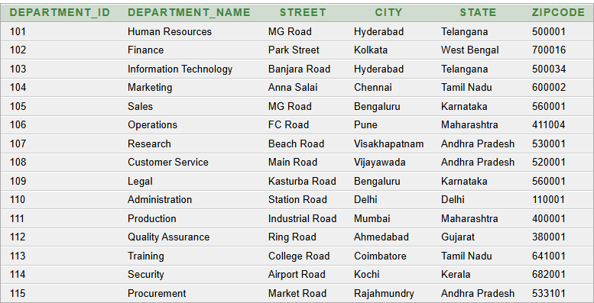
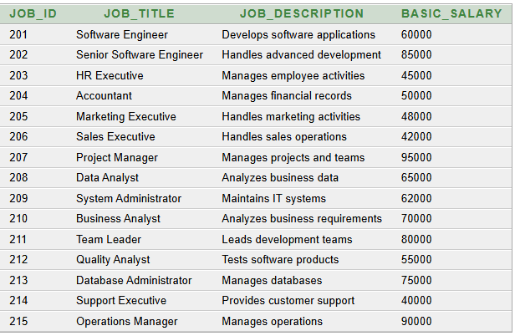
DEPARTMENT TABLE
JOB TABLE
SELECT * FROM DEPARTMENT;
SELECT * FROM JOB;

Slide 22
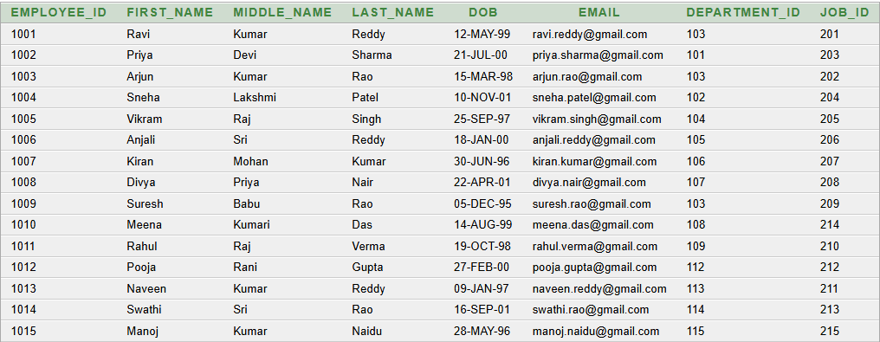
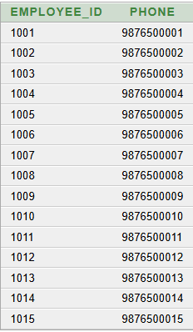
EMPLOYEE TABLE
EMPLOYEE_PHONE TABLE
SELECT * FROM EMPLOYEE;
SELECT * FROM EMPLOYEE_PHONE;

Slide 23
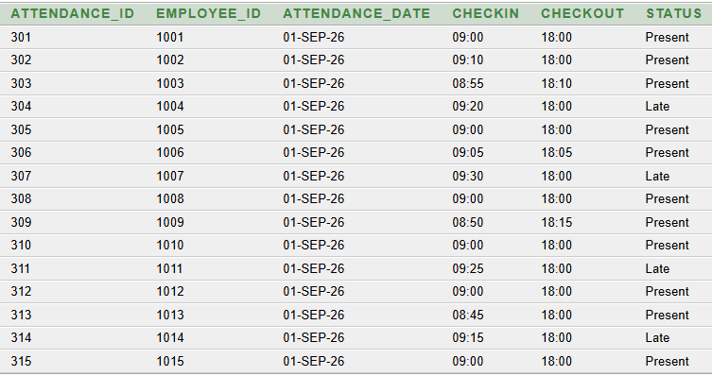
ATTENDENCE TABLE
SELECT * FROM ATTENDANCE;

Slide 24
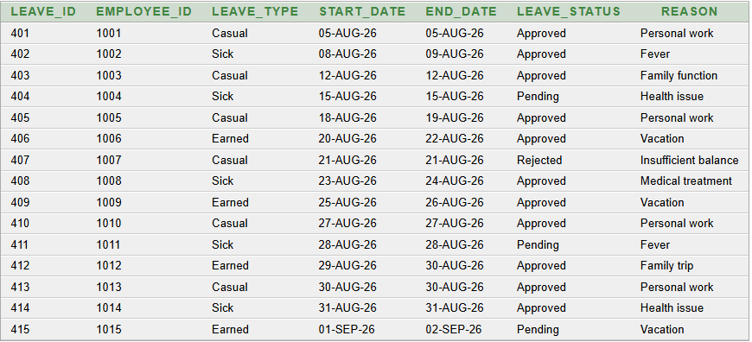
LEAVE TABLE
SELECT * FROM LEAVE;

Slide 25
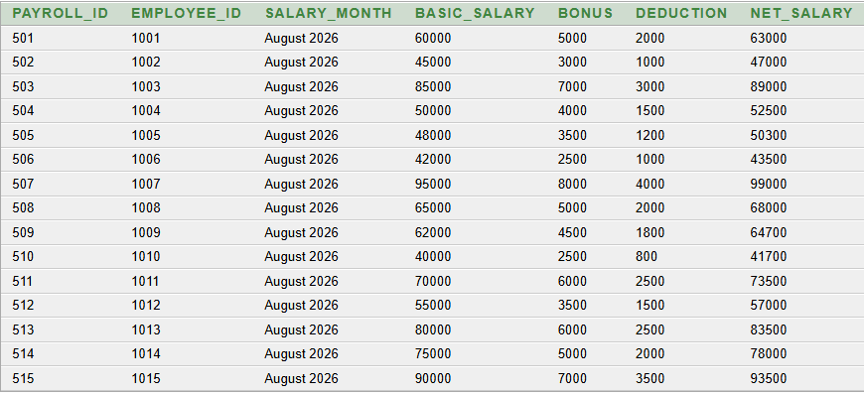
PAYROLL TABLE
SELECT * FROM PAYROLL;

Slide 26
QUERIES
Basic Queries:
Display all employees
SELECT * FROM EMPLOYEE;

Slide 27
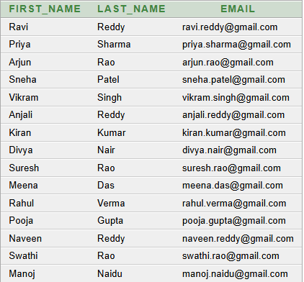
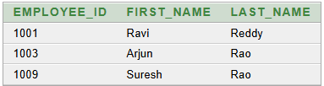
2. Display employee names and email
SELECT FIRST_NAME, LAST_NAME, EMAIL FROM EMPLOYEE;
3. Find employees from IT department
SELECT EMPLOYEE_ID, FIRST_NAME, LAST_NAME FROM EMPLOYEE
WHERE DEPARTMENT_ID = 103;

Slide 28
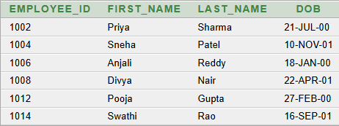
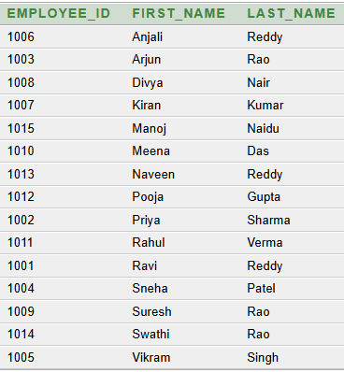
4. Display employees born after January 1, 2000
SELECT EMPLOYEE_ID, FIRST_NAME, LAST_NAME, DOB
FROM EMPLOYEE
WHERE DOB > DATE '2000-01-01';
5. Display employees in alphabetical order
SELECT EMPLOYEE_ID, FIRST_NAME, LAST_NAME
FROM EMPLOYEE
ORDER BY FIRST_NAME ASC;

Slide 29
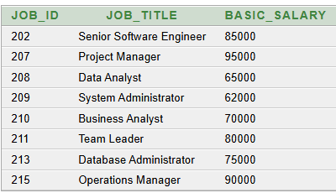
6. Find jobs with salary greater than 60000
SELECT JOB_ID, JOB_TITLE, BASIC_SALARY
FROM JOB
WHERE BASIC_SALARY > 60000;
7. Find employees whose first name starts with 'R’
SELECT * FROM EMPLOYEE
WHERE FIRST_NAME LIKE 'R%';

Slide 30
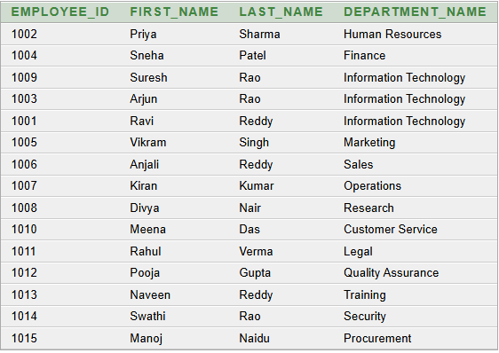
Advanced Queries:
Display employees with their department names
SELECT E.EMPLOYEE_ID,
E.FIRST_NAME,
E.LAST_NAME,
D.DEPARTMENT_NAME
FROM EMPLOYEE E
JOIN DEPARTMENT D
ON E.DEPARTMENT_ID = D.DEPARTMENT_ID;

Slide 31
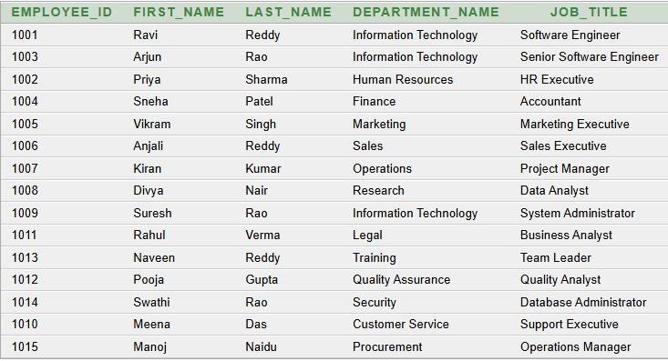
2. Display employee, department, and job details
SELECT E.EMPLOYEE_ID,
E.FIRST_NAME,
E.LAST_NAME,
D.DEPARTMENT_NAME,
J.JOB_TITLE
FROM EMPLOYEE E
JOIN DEPARTMENT D
ON E.DEPARTMENT_ID = D.DEPARTMENT_ID
JOIN JOB J
ON E.JOB_ID = J.JOB_ID;

Slide 32
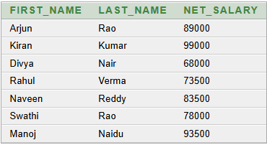

3. Find the employee with the highest net salary
SELECT E.FIRST_NAME,
E.LAST_NAME,
P.NET_SALARY
FROM EMPLOYEE E
JOIN PAYROLL P
ON E.EMPLOYEE_ID = P.EMPLOYEE_ID
WHERE P.NET_SALARY =
(
SELECT MAX(NET_SALARY)
FROM PAYROLL
);
4. Find employees earning above the average salary
SELECT E.FIRST_NAME,
E.LAST_NAME,
P.NET_SALARY
FROM EMPLOYEE E
JOIN PAYROLL P
ON E.EMPLOYEE_ID = P.EMPLOYEE_ID
WHERE P.NET_SALARY >
(
SELECT AVG(NET_SALARY)
FROM PAYROLL
);

Slide 33
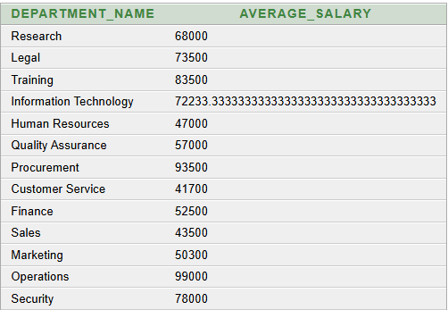
5. Find average salary department-wise
SELECT D.DEPARTMENT_NAME,
AVG(P.NET_SALARY) AS AVERAGE_SALARY
FROM EMPLOYEE E
JOIN DEPARTMENT D
ON E.DEPARTMENT_ID = D.DEPARTMENT_ID
JOIN PAYROLL P
ON E.EMPLOYEE_ID = P.EMPLOYEE_ID
GROUP BY D.DEPARTMENT_NAME;

Slide 34
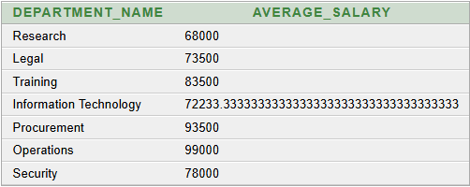
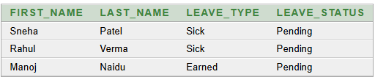
6. Find departments having average salary greater than 60000
SELECT D.DEPARTMENT_NAME,
AVG(P.NET_SALARY) AS AVERAGE_SALARY
FROM EMPLOYEE E
JOIN DEPARTMENT D
ON E.DEPARTMENT_ID = D.DEPARTMENT_ID
JOIN PAYROLL P
ON E.EMPLOYEE_ID = P.EMPLOYEE_ID
GROUP BY D.DEPARTMENT_NAME
HAVING AVG(P.NET_SALARY) > 60000;
7. Find employees who have pending leave
SELECT E.FIRST_NAME,
E.LAST_NAME,
L.LEAVE_TYPE,
L.LEAVE_STATUS
FROM EMPLOYEE E
JOIN LEAVE L
ON E.EMPLOYEE_ID = L.EMPLOYEE_ID
WHERE L.LEAVE_STATUS = 'Pending';

Slide 35
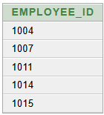
8. Find employees who are either late or have pending leave
SELECT EMPLOYEE_ID
FROM ATTENDANCE
WHERE STATUS = 'Late'
UNION
SELECT EMPLOYEE_ID
FROM LEAVE
WHERE LEAVE_STATUS = 'Pending';

Slide 36
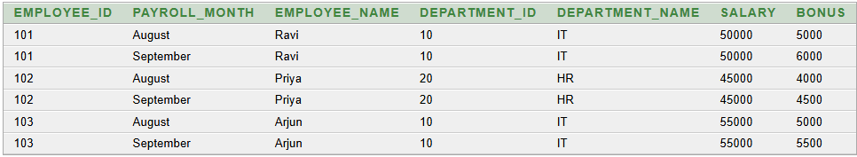
FIRST NORMAL FORM
SCHEMA
1NF:
All attributes contain single/atomic values.
Employee, department, and payroll information are stored in individual rows.
Each attribute contains one value for each record.
Each payroll record is uniquely identified by the composite key (EMPLOYEE_ID, PAYROLL_MONTH).
Salary and bonus are recorded for each employee and payroll month.
There are no repeating groups or multivalued attributes.
PAYROLL_1NF ( EMPLOYEE_ID, PAYROLL_MONTH, EMPLOYEE_NAME, DEPARTMENT_ID, DEPARTMENT_NAME, SALARY, BONUS )
PRIMARY KEY: (EMPLOYEE_ID, PAYROLL_MONTH)

Slide 37
FUNCTIONAL DEPENDENCIES:
(EMPLOYEE_ID, PAYROLL_MONTH) → SALARY
(EMPLOYEE_ID, PAYROLL_MONTH) → BONUS
EMPLOYEE_ID → EMPLOYEE_NAME
EMPLOYEE_ID → DEPARTMENT_ID
DEPARTMENT_ID → DEPARTMENT_NAME
ANOMALIES IN 1NF:
1. Update Anomaly
Employee and department details are repeated for every payroll month.
2. Insert Anomaly
A new employee cannot be easily inserted unless a payroll record is also available.
3. Delete Anomaly
Deleting a payroll record may accidentally remove important employee information.

Slide 38
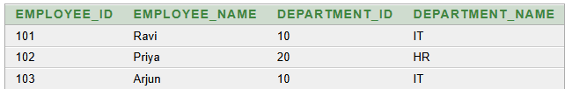
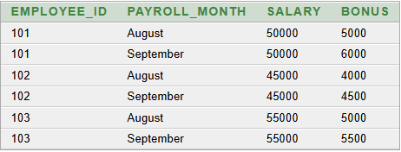
SECOND NORMAL FORM
SCHEMA :
EMPLOYEE_2NF ( EMPLOYEE_ID, EMPLOYEE_NAME, DEPARTMENT_ID, DEPARTMENT_NAME )
SCHEMA:
PAYROLL_2NF ( EMPLOYEE_ID, PAYROLL_MONTH, SALARY, BONUS )
PRIMARY KEY: EMPLOYEE_ID
FUNCTIONAL DEPENDENCIES:
EMPLOYEE_ID → EMPLOYEE_NAME
EMPLOYEE_ID → DEPARTMENT_ID
DEPARTMENT_ID → DEPARTMENT_NAME
PRIMARY KEY(EMPLOYEE_ID, PAYROLL_MONTH)
FOREIGN KEY:EMPLOYEE_ID → EMPLOYEE_2NF(EMPLOYEE_ID)
FUNCTIONAL DEPENDENCIES
(EMPLOYEE_ID, PAYROLL_MONTH) → SALARY (EMPLOYEE_ID, PAYROLL_MONTH) → BONUS

Slide 39
PARTIAL DEPENDENCIES:
EMPLOYEE_ID → EMPLOYEE_NAME EMPLOYEE_ID → DEPARTMENT_ID
ANOMALIES IN 2NF:
Update Anomaly: Department information may be repeated for employees belonging to the same department.
Insert Anomaly: A department cannot be stored independently without an employee.
Delete Anomaly: Deleting the last employee of a department may cause the department information to be lost
2NF:
Remove partial dependency.
Separate Employee details from Payroll details.
EMPLOYEE_ID → EMPLOYEE_NAME, DEPARTMENT_ID
Payroll details depend on both EMPLOYEE_ID and PAYROLL_MONTH.
Create EMPLOYEE_2NF and PAYROLL_2NF tables.
No partial dependency remains.

Slide 40
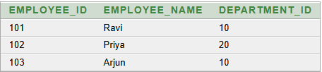

THIRD NORMAL FORM
SCHEMA:
EMPLOYEE_3NF ( EMPLOYEE_ID, EMPLOYEE_NAME, DEPARTMENT_ID )
SCHEMA
DEPARTMENT_3NF
(
DEPARTMENT_ID,
DEPARTMENT_NAME)
Primary Key: EMPLOYEE_ID
FUNCTIONAL DEPENDENCIES
EMPLOYEE_ID → EMPLOYEE_NAME
EMPLOYEE_ID → DEPARTMENT_ID
DEPARTMENT_ID → DEPARTMENT_NAME
Primary Key: DEPARTMENT_ID
Foreign Key: DEPARTMENT_ID ->DEPARTMENT_3NF(DEPARTMENT_ID)

Slide 41
3NF ANOMALIES:
Insertion Anomaly:
We can add a new department in DEPARTMENT_3NF without adding an employee.
Update Anomaly:
If a department name needs to be changed, we update it only once in DEPARTMENT_3NF.
Deletion Anomaly:
Deleting an employee does not delete the department information, because department details are stored separately.
3NF:
The table is already in 2NF.
Remove transitive dependency.
Department details are separated into a Department table.
DEPARTMENT_ID is the primary key in the Department table.
EMPLOYEE_ID is the primary key in the Employee table.
DEPARTMENT_ID is used as a foreign key in the Employee table.
Now, all non-key attributes depend directly on the primary key.
This reduces insertion, update, and deletion anomalies.

Slide 42
CONCLUSION
The Payroll Management System provides a centralized and structured way to manage employee payroll information. It reduces manual effort, improves accuracy, and organizes employee records efficiently. The system also maintains attendance, leave, and payroll details, making data retrieval and report generation easier. Overall, it provides an efficient, reliable, and well-organized database solution for effective payroll management.

Slide 43
THANK YOU

